Slide 1


ADICHUNCHANAGIRI INSTITUTE OF TECHNOLOGY, CHIKMAGALUR
DEPARTMENT OF COMPUTER SCIENCE & ENGINEERING
PROJECT PHASE-2 PROGRESS SEMINAR (BOARD WORK PRESENTATION)
ON
Printed Circuit Board Defect Detection
using CNN
Under the Guidance of
Mr. CHANDRA NAIK G B.E., M.Tech., KSET.,
Assistant Professor,
Department of Computer Science & Engineering
Presented By
Koushik Lokesh K (4AI19CS057) Daivik M D (4AI20CS026)
Deekshith K (4AI20CS028) Sujay G (4AI20CS109)
Dept.of CS&E, A.I.T, Chikkamagaluru

Slide 2
ABSTRACT
A Printed Circuit Board (PCB) is a flat board made of insulating material on which electronic
components are mounted.
Traditional methods of inspection are time-consuming and often prone to errors. By using deep
learning technique YOLOv5, the project aims to perform PCB inspection process.
YOLOv5, a state-of-the-art object detection framework. By employing YOLOv5, the system can
swiftly identify and classify a wide range of defects on PCBs.
The proposed project surpasses traditional methods by providing comprehensive defect detection
and classification.
Various types of defects, such as soldering issues and circuitry abnormalities can be accurately
identified.
Dept.of CS&E, A.I.T, Chikkamagaluru

Slide 3
contents
1. INTRODUCTION
Motivation
Problem Statement
Objectives
Scope
Review of Literature
2. SYSTEM REQUIREMENT SPECIFICATION
Hardware Requirements
Software Requirements
Functional Requirements
Non-Functional Requirements
3. HIGH LEVEL DESIGN
System Architecture
Use case Diagram
Flowchart
4. BOARD WORK
Image Acquisition
Pre-Processing
Convolutional Neural Networks
5. IMPLEMENTATION
Pseudocode for Preprocessing techniques
6. SYSTEM TESTING
Unit Testing
7. RESULT AND DISCUSSION
Snapshots of results
8. CONCLUSION AND FUTURE ENHANCEMENTS
REERENCES
Dept.of CS&E, A.I.T, Chikkamagaluru

Slide 4
introduction
This project aims to create a smart system that can find and understand issues in
printed circuit boards (PCBs) all by itself.
It can look at pictures of PCBs and instantly tell if something is wrong. This speed is
important for factories where fast problem-solving is crucial.
By using this system, factories can make sure their products are of top quality.
It helps catch mistakes early, making the manufacturing process faster and more
efficient.
Dept.of CS&E, A.I.T, Chikkamagaluru

Slide 5
introduction
MOTIVATION
Automate PCB defect detection to enhance efficiency, reduce costs, and improve product quality.
Implement a real-time defect detection system to prevent the production of defective PCBs and reduce costs.
Leverage deep learning to automate defect detection for complex PCB designs.
Enhance manufacturing accuracy and reliability through automated PCB defect detection.
Dept.of CS&E, A.I.T, Chikkamagaluru

Slide 6
introduction
PROBLEM STATEMENT
Input: Images of Printed Circuit Boards.
Process: By using different image processing techniques, input PCBs image is pre-processed and then the region of interest is extracted from input PCB image and classified using CNN algorithm.
Processing Techniques:- * Conversion of RGB to Grayscale
* Median Filtering
* Thresholding
* High-pass Filtering
Output: Detects and Classify the defects in printed circuit board.
Dept.of CS&E, A.I.T, Chikkamagaluru

Slide 7
introduction
OBJECTIVES
To develop a custom dataset of PCB images with labeled defects.
To train the model on custom dataset to detect and classify the defects.
To evaluate the performance of the trained model on held-out test set.
To develop a user-friendly interface for the system.
To deploy the system in a production environment.
Dept.of CS&E, A.I.T, Chikkamagaluru

Slide 8
introduction
SCOPE
Manufacturers can deploy this system in their production lines, ensuring that defective
PCBs are detected early in the manufacturing process.
Automated defect detection reduces the need for manual inspection, which can be time-
consuming and costly.
Early detection of defects leads to reduced wastage of materials and resources.
By ensuring that only defect-free PCBs are used in electronic products, the overall
reliability of electronic devices can be improved.
Dept.of CS&E, A.I.T, Chikkamagaluru

Slide 9
introduction
LITERATURE SURVEY
Sl. No | Title& Published year | Authors | Description | Remarks
1 | Automated Defect Detection in PCBs: A Review Published in year 2020 | Smith, John; Johnson, Emily | This review paper provides an overview of various methodologies and techniques for PCB defect detection, including machine learning, image processing, and computer vision approaches. It summarizes the state-of-the-art methods and their advantages and disadvantages . | The work has been extended to include identification of defects in printed circuit boards.
2 | Real-Time Defect Detection in PCB Manufacturing Using Computer Vision Published in year 2019. | Wang, Wei; Li, Ming; Zhang, Hong | This study proposes a real-time defect detection system using computer vision techniques. It employs image processing algorithms and a neural network-based classifier to identify defects such as cracks and soldering issues in PCBs. | The test results provides defects such as cracks and soldering issues to be detected using image processing algorithms.
Dept.of CS&E, A.I.T, Chikkamagaluru

Slide 10
introduction
LITERATURE SURVEY
Sl. No | Title& Published year | Authors | Description | Remarks
3 | Anomaly Detection for PCB Inspection: A Deep Learning Approach . Published in year 2018 | Chen, Li; Wu, Qian; Wang, Xin | This research explores the application of deep learning, specifically convolutional neural networks (CNNs), for PCB defect detection. It uses labeled datasets to train the CNN model to recognize various defects on PCBs. | The convolutional neural network is used to classify various defects of printed circuit board.
4 | Machine Vision-Based Automated Inspection of PCBs: A Comparative Study Published in year 2017. | Kumar, Rajesh; Gupta, Suresh | This study conducts a comparative analysis of different machine vision techniques for PCB inspection. It evaluates the performance of traditional image processing methods and newer machine learning approaches in detecting defects. | The result would improve the identification and classification of defects in printed circuit board
Dept.of CS&E, A.I.T, Chikkamagaluru

Slide 11
introduction
LITERATURE SURVEY
Sl. No | Title& Published year | Authors | Description | Remarks
5 | Defect Detection in PCBs Using Transfer Learning with Pretrained CNNs Published in year 2016. | Lee, Hyun; Kim, Seong; Park, Min | This research proposes a transfer learning approach for PCB defect detection. It fine-tunes pretrained convolutional neural networks (CNNs) on PCB defect datasets to leverage the power of deep learning for this task. | The detection and classification of various defects in printed circuit board is achieved by convolutional neural network.
Dept.of CS&E, A.I.T, Chikkamagaluru

Slide 12
SYSTEM REQUIREMENT SPECIFICATION
HARDWARE REQUIREMENTS
Hard Disk : 256 GB
System : Intel i3/i5 2.4 GHz
RAM : 8 GB
SOFTWARE REQUIREMENTS
Operating System : Windows XP/Windows 10
Software Tool : Open CV
Framework and Test : Flask
Programming Language : Python
Tools : IDLE(python 3.7.0)
Dept.of CS&E, A.I.T, Chikkamagaluru

Slide 13
SYSTEM REQUIREMENT SPECIFICATION
FUNCTIONAL REQUIREMENTS
Useful requirements describe the product's internal activities: that is, the technical subtitles, monitoring and handling of data and other specific functionality demonstrating how to satisfy the use cases. They are upheld by non-utilitarian prerequisites that force the plan or execution of imperatives.
System should process the data.
System should segment the PCB images.
System should detect the PCB image.
System should detect and classify the defects in PCB images.
Dept.of CS&E, A.I.T, Chikkamagaluru

Slide 14
SYSTEM REQUIREMENT SPECIFICATION
NON-FUNCTIONAL REQUIREMENTS
Non-practical preconditions are often referred to as system utilities. Different terms for non-practical necessities are "limitations, “quality characteristics" and "prerequisites for administration".
The architecture should be created in order to incorporate new modules and functionalities, thereby promoting application development. The cost should be small as a result of programming packages being freely accessible.
Usability: System should be user friendly.
Reliability: The system should be reliable.
Performance: The system should not take excess time in detecting the defects in PCB images.
Supportability: System should be easily updatable for future enhancement.
Dept.of CS&E, A.I.T, Chikkamagaluru

Slide 15
HIGH LEVEL DESIGN
ARCHITECTURE DIAGRAM
Input Image
Image
Pre-processing
Image
segmentation
Feature extraction
Defect classification
Image
database
Information synthesis
Data management
Information display
Fig 1: Architecture Diagram
Dept.of CS&E, A.I.T, Chikkamagaluru

Slide 16
HIGH LEVEL DESIGN
USECASE DIAGRAM
II
Input
Pre-processing
F
Feature extraction
Training Model
Classification
Select PCB image
System
User
Display result
Fig 2: Use case diagram
Dept.of CS&E, A.I.T, Chikkamagaluru

Slide 17
HIGH LEVEL DESIGN
FLOWCHART
START
Image Collection
Split dataset
Train
Test
Pre-processing
Feature extraction
Defect classification
Defect?
Yes
No
Normal
Specific PCB Defect
END
Dept.of CS&E, A.I.T, Chikkamagaluru
Fig 3: Flowchart

Slide 18
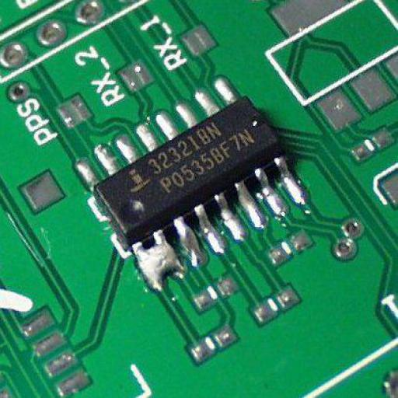
IMAGE ACQUISITION
Image: Printed Circuit Board
Defect name :Soldering Short Dimension :512 X 512 Width :512 pixels Height :512 pixels Type of file :JPG file(.jpg) Size :156 KB
Dept.of CS&E, A.I.T, Chikkamagaluru

Slide 19
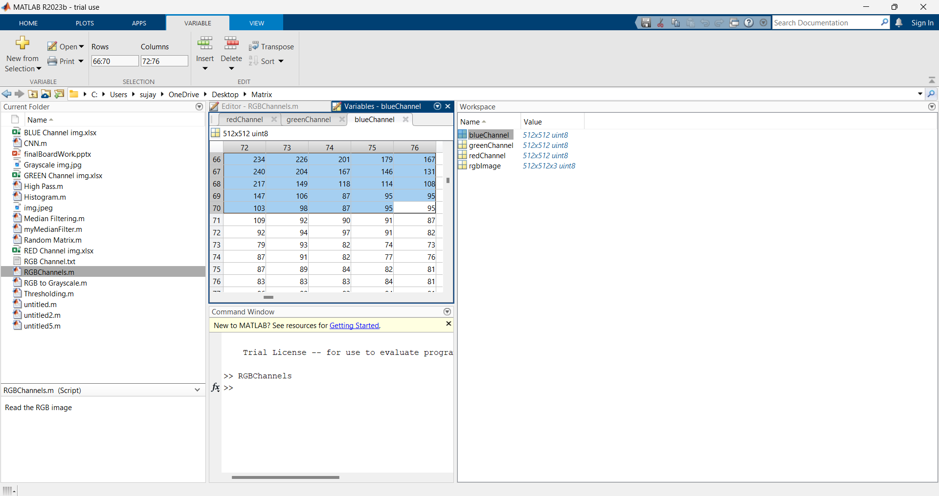
BOARD WORK
PRE-PROCESSING
% Read the RGB image
rgbImage = imread('img.jpeg');
% Extract the individual RGB channels
redChannel = rgbImage(:, :, 1);
greenChannel = rgbImage(:, :, 2);
blueChannel = rgbImage(:, :, 3);
Dept.of CS&E, A.I.T, Chikkamagaluru

Slide 20
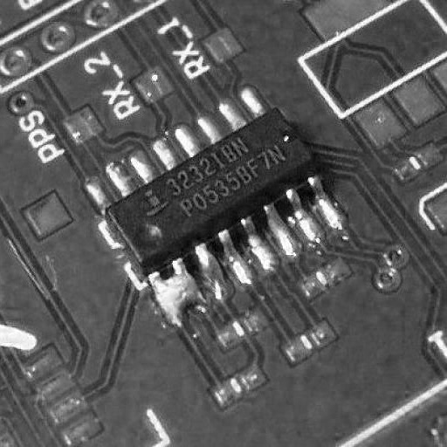
BOARD WORK
PRE-PROCESSING
The formula:
0.2989*R+0.5870*G+0.1140*B
Conversion from RGB to Grayscale:
RED COMPONENT
GREEN COMPONENT
BLUE COMPONENT
249 | 236 | 205 | 173 | 150
249 | 209 | 165 | 136 | 109
218 | 147 | 110 | 97 | 83
138 | 93 | 68 | 68 | 61
82 | 74 | 58 | 59 | 54
242 | 236 | 218 | 203 | 196
251 | 217 | 186 | 172 | 163
232 | 168 | 142 | 143 | 145
167 | 131 | 117 | 129 | 136
132 | 131 | 126 | 137 | 143
234 | 226 | 201 | 179 | 167
240 | 204 | 167 | 146 | 131
217 | 149 | 118 | 114 | 108
147 | 106 | 87 | 95 | 95
103 | 98 | 87 | 95 | 95
243 | 235 | 212 | 191 | 179
249 | 213 | 178 | 158 | 143
226 | 160 | 130 | 126 | 121
156 | 117 | 99 | 107 | 109
114 | 110 | 101 | 109 | 111
Fig 4: Conversion from RGB to Grayscale
Dept.of CS&E, A.I.T, Chikkamagaluru

Slide 21
BOARD WORK
MEDIAN FILTERING
Noise removal:
Noise removal algorithm is the process of removing or reducing the noise from the image. The noise removal algorithms reduce or remove the visibility of noise by smoothing the entire image leaving areas near contrast boundaries.
Here we are making use of Median Filter which is a Noise Removal Technique.
Median Filtering:
The median filter is a non-linear digital filtering technique, often used to remove noise from an image or signal.
Here 0’s are appended at the edged and corners to the matrix which is the representation of the grey scale image.
Then for every3*3 matrix, arrange elements in ascending order, then find median/middle element of those 9 elements .
The formula:G(x, y, σ) = 1/ √ 2πσ2 e −( x 2+y 2)/ 2σ2
The formula : k = M+1 /2
Dept.of CS&E, A.I.T, Chikkamagaluru

Slide 22
BOARD WORK
MEDIAN FILTERING
The Original matrix:
Append 0s at edges and corners :
0
0
0
0
0
0
0
243 | 235 | 212 | 191 | 179
249 | 213 | 178 | 158 | 143
226 | 160 | 130 | 126 | 121
156 | 117 | 99 | 107 | 109
114 | 110 | 101 | 109 | 111
0
243 | 235 | 212 | 191 | 179
249 | 213 | 178 | 158 | 143
226 | 160 | 130 | 126 | 121
156 | 117 | 99 | 107 | 109
114 | 110 | 101 | 109 | 111
0
0
0
0
0
0
0
0
0
0
0
0
0
0
0
0
The enhanced matrix:
0 | 212 | 178 | 158 | 0
213 | 213 | 178 | 158 | 126
156 | 160 | 130 | 126 | 109
114 | 117 | 110 | 109 | 109
0 | 101 | 101 | 101 | 0
Fig 5: Noise filtering using Median Filter
Dept.of CS&E, A.I.T, Chikkamagaluru

Slide 23

BOARD WORK
THRESHOLDING
Considering each pixel values , if the pixel value is greater than or equal to the threshold T, retain it.
Else, replace the value by 0.
Here, the value of T can be manipulated in the frontend, to suit the varying needs of different images. We use trial and error method here
0 | 212 | 178 | 158 | 0
213 | 213 | 178 | 158 | 126
156 | 160 | 130 | 126 | 109
114 | 117 | 110 | 109 | 109
0 | 101 | 101 | 101 | 0
0 | 212 | 178 | 158 | 0
213 | 213 | 178 | 158 | 0
156 | 160 | 130 | 0 | 0
0 | 0 | 0 | 0 | 0
0 | 0 | 0 | 0 | 0
Suppose, T=130
Fig 6: Thresholding using Basic global Thresholding
Dept.of CS&E, A.I.T, Chikkamagaluru

Slide 24
BOARD WORK
HIGH-PASS FILTERING
Image Sharpening:
Image sharpening refers to any enhancement technique that highlights edges and fine details in an image. Increasing yields a more sharpened image.
High-Pass Filtering:
A high-pass filter can be used to make an image appear sharper. These filters emphasize fine details in the image
The formula : fsharp(x, y) = f (x, y) + k(f (x, y) − fsmooth(x, y))
Dept.of CS&E, A.I.T, Chikkamagaluru

Slide 25
BOARD WORK
HIGH-PASS FILTERING
The Original matrix :
The filtered matrix :
0
0
0
0
0
0
0
0
0 | 212 | 178 | 158 | 0
213 | 213 | 178 | 158 | 0
156 | 160 | 130 | 0 | 0
0 | 0 | 0 | 0 | 0
0 | 0 | 0 | 0 | 0
0
-71 | 102 | 56 | 83 | -35
107 | 53 | 24 | 69 | -35
74 | 43 | 37 | -52 | -18
-35 | -50 | -32 | -14 | 0
0 | 0 | 0 | 0 | 0
-1 | -1 | -1
-1 | 8 | -1
-1 | -1 | -1
0
0
0
0
X 1/9
0
0
0
0
0
0
0
0
0
0
0
After rejecting negatives:
0 | 102 | 56 | 83 | 0
107 | 53 | 24 | 69 | 0
74 | 43 | 37 | 0 | 0
0 | 0 | 0 | 0 | 0
0 | 0 | 0 | 0 | 0
Fig 7: Image Sharpening using High-Pass Filter
Dept.of CS&E, A.I.T, Chikkamagaluru

Slide 26
BOARD WORK
HIGH-PASS FILTERING
Boundary extension at edges and corners:
The filtered matrix :
0
0
102
56
83
0
0
0
0 | 102 | 56 | 83 | 0
107 | 53 | 24 | 69 | 0
74 | 43 | 37 | 0 | 0
0 | 0 | 0 | 0 | 0
0 | 0 | 0 | 0 | 0
0
-52 | 46 | -14 | 42 | -26
45 | -2 | -28 | 39 | -17
23 | 5 | 12 | -14 | -8
-21 | -17 | -9 | -4 | 0
0 | 0 | 0 | 0 | 0
107
0
-1 | -1 | -1
-1 | 8 | -1
-1 | -1 | -1
74
0
X 1/9
0
0
0
0
0
0
0
0
0
0
0
After rejecting negatives:
0 | 46 | 0 | 42 | 0
45 | 0 | 0 | 39 | 0
23 | 5 | 12 | 0 | 0
0 | 0 | 0 | 0 | 0
0 | 0 | 0 | 0 | 0
Fig 8: Image Sharpening using High-Pass Filter
Dept.of CS&E, A.I.T, Chikkamagaluru

Slide 27
BOARD WORK
CONVOLUTIONAL NEURAL NETWORK
Image acquisition:
The image is obtained from the videos which were captured from the surveillance cameras. Suspicious Images are considered for undergoing this process.
CNN Model:
CNNs have shown encouraging performance in numerous computer vision problems and applications, such as object detection and localization, image segmentation, super-resolution, classification, and indexing and retrieval. This widespread success is due to their hierarchical structure, which automatically learns very strong features from raw data.
A typical CNN architecture consists of three well-known processing layers.
1) A convolution layer, where various feature maps are produced when different kernels are applied to the input data.
Dept.of CS&E, A.I.T, Chikkamagaluru

Slide 28
2) A pooling layer, which is used for the selection of maximum activation considering small neighborhood feature maps received from the previous convolution layer; the goal of this layer is to achieve translation invariance to some extent and dimensionality reduction.
3) A fully connected layer which models high-level information from the input data and constructs its global representation. This layer follows numerous stacks of convolution and pooling layers, thus resulting in a high level representation of the input data
Extracting feature map:
The activation maps, called feature maps, capture the result of applying the filters to input, such as the input image or another feature map. The idea of visualizing a feature map for a specific input image would be to understand what features of the input are detected or preserved in the feature maps.
Dept.of CS&E, A.I.T, Chikkamagaluru

Slide 29
BOARD WORK
HISTOGRAM ORIENTATION GRADIENT
The Histogram of Oriented Gradients (HOG) is a feature descriptor used in computer vision and image processing for the purpose of object detection. The technique counts occurrences of gradient orientation in in localized portions of an image.
Here 0’s are appended at the edges and corners to the matrix. Then Gx and Gy are calculated. Gx is calculates as Gx = value on right –value on left and Gy is calculated as Gy=value on top-value on bottom. Figure 12 shows Gx and Gy in HOG.
Dept.of CS&E, A.I.T, Chikkamagaluru

Slide 30
BOARD WORK
HISTOGRAM ORIENTATION GRADIENT
The Input :
0
0
0
0
0
0
0
0
0 | 46 | 0 | 42 | 0
45 | 0 | 0 | 39 | 0
23 | 5 | 12 | 0 | 0
0 | 0 | 0 | 0 | 0
0 | 0 | 0 | 0 | 0
0
0
0
0
0
0
0
0
0
Gx :
0
0
0
0
0
0
0
Gy :
46 | 0 | -4 | 0 | -42
0 | -45 | 39 | 0 | -39
5 | 11 | -5 | -12 | 0
0 | 0 | 0 | 0 | 0
0 | 0 | 0 | 0 | 0
-45 | 0 | 0 | -39 | 0
-23 | 41 | -12 | 42 | 0
45 | 0 | 0 | 39 | 0
23 | 5 | 12 | 0 | 0
0 | 0 | 0 | 0 | 0
Fig 9: Gx and Gy in HOG.
Dept.of CS&E, A.I.T, Chikkamagaluru

Slide 31
BOARD WORK
HISTOGRAM ORIENTATION GRADIENT
Then, using the formula given in fig 13, Magnitude and the orientation are calculated. Feature Extraction using HOG is shown in figure 13, Magnitude is the illumination and degree is the angle of orientation
After the angle of orientation is calculated, the frequency the angles for the particular intervals area are noted and they are given as input for the classifier. Here zeroes are not considered for finding the frequency. For example for the interval from 40 to 59 there are 2 occurrences, so we are writing the frequency as 2.
Dept.of CS&E, A.I.T, Chikkamagaluru

Slide 32
The formula :
Magnitude= √(Gx² +Gy²
∅=tan⁻¹(Gy/Gx)
Magnitude :
∅ :
64.35 | 0 | 4 | 39 | 42
23 | 60.87 | 40.80 | 42 | 39
45.27 | 11 | 5 | 40.80 | 0
23 | 5 | 12 | 0 | 0
0 | 0 | 0 | 0 | 0
-44.37 | 0 | 0 | 0 | 0
0 | -42.33 | -17.10 | 0 | 0
-83.65 | 0 | 0 | -72.89 | 0
0 | 0 | 0 | 0 | 0
0 | 0 | 0 | 0 | 0
Dept.of CS&E, A.I.T, Chikkamagaluru

Slide 33
BOARD WORK
CONVOLUTIONAL NEURAL NETWORKS
0 | 46 | 0 | 42 | 0
45 | 0 | 0 | 39 | 0
23 | 5 | 12 | 0 | 0
0 | 0 | 0 | 0 | 0
0 | 0 | 0 | 0 | 0
1 | 0 | -1
1 | 0 | -1
1 | 0 | -1
56
X
0 | 46 | 0 | 42 | 0
45 | 0 | 0 | 39 | 0
23 | 5 | 12 | 0 | 0
0 | 0 | 0 | 0 | 0
0 | 0 | 0 | 0 | 0
1 | 0 | -1
1 | 0 | -1
1 | 0 | -1
56 | -30
X
0 | 46 | 0 | 42 | 0
45 | 0 | 0 | 39 | 0
23 | 5 | 12 | 0 | 0
0 | 0 | 0 | 0 | 0
0 | 0 | 0 | 0 | 0
1 | 0 | -1
1 | 0 | -1
1 | 0 | -1
53 | -32 | 12
X
Dept.of CS&E, A.I.T, Chikkamagaluru

Slide 34
BOARD WORK
CONVOLUTIONAL NEURAL NETWORKS
0 | 46 | 0 | 42 | 0
45 | 0 | 0 | 39 | 0
23 | 5 | 12 | 0 | 0
0 | 0 | 0 | 0 | 0
0 | 0 | 0 | 0 | 0
1 | 0 | -1
1 | 0 | -1
1 | 0 | -1
56 | -30 | 12
56
X
0 | 46 | 0 | 42 | 0
45 | 0 | 0 | 39 | 0
23 | 5 | 12 | 0 | 0
0 | 0 | 0 | 0 | 0
0 | 0 | 0 | 0 | 0
1 | 0 | -1
1 | 0 | -1
1 | 0 | -1
56 | -30 | 12
56 | -34
X
0 | 46 | 0 | 42 | 0
45 | 0 | 0 | 39 | 0
23 | 5 | 12 | 0 | 0
0 | 0 | 0 | 0 | 0
0 | 0 | 0 | 0 | 0
1 | 0 | -1
1 | 0 | -1
1 | 0 | -1
56 | -30 | 12
56 | -34 | 12
X
Dept.of CS&E, A.I.T, Chikkamagaluru

Slide 35
BOARD WORK
CONVOLUTIONAL NEURAL NETWORKS
0 | 46 | 0 | 42 | 0
45 | 0 | 0 | 39 | 0
23 | 5 | 12 | 0 | 0
0 | 0 | 0 | 0 | 0
0 | 0 | 0 | 0 | 0
1 | 0 | -1
1 | 0 | -1
1 | 0 | -1
56 | -30 | 12
56 | -34 | 12
11
X
0 | 46 | 0 | 42 | 0
45 | 0 | 0 | 39 | 0
23 | 5 | 12 | 0 | 0
0 | 0 | 0 | 0 | 0
0 | 0 | 0 | 0 | 0
1 | 0 | -1
1 | 0 | -1
1 | 0 | -1
56 | -30 | 12
56 | -34 | 12
11 | 5
X
0 | 46 | 0 | 42 | 0
45 | 0 | 0 | 39 | 0
23 | 5 | 12 | 0 | 0
0 | 0 | 0 | 0 | 0
0 | 0 | 0 | 0 | 0
1 | 0 | -1
1 | 0 | -1
1 | 0 | -1
56 | -30 | 12
56 | -34 | 12
11 | 5 | 12
X
Dept.of CS&E, A.I.T, Chikkamagaluru

Slide 36
POOLING LAYER
56 | -30 | 12
56 | -34 | 12
11 | 5 | 12
56 | 12
56 | 12
Pooling Layer
[Max Pooling]
Pooled output:
2*2 Matrix
In Pooling layer 3*3 matrix is reduced to 2*2 matrix, this is done by selecting the maximum of the particular 2*2 matrix for the particular position. Figure 15 shows the Pooling Layer.
Dept.of CS&E, A.I.T, Chikkamagaluru

Slide 37
FULLY CONNECTED LAYER AND OUTPUT LAYER
56
12
56
12
56 | 12
56 | 12
THE FULLY
CONNECTED LAYER
From Pooling layer
Flattened Matrix
Hidden layers
Input
layer
Output
layer
Sigmoid
Activation
function
56
12
56
12
Printed Circuit Board
Soldering Short
.
.
One
Dimensional
Array
No Defect
Fig 10: Fully connected layer and Output layer
37
Dept.of CS&E, A.I.T, Chikkamagaluru

Slide 38
Fully-connected layers, also known as linear layers, connects every input neuron to every output neuron and are commonly used in neural networks. The output of the pooling layer is flattened and this flattened matrix is fed into the Fully Connected Layer. In the fully connected layer there are many layers, Input layer, Hidden layer and Output layers are parts of it. Figure 16 shows the Fully connected layer and Output Layer.
SIGMOID ACTIVATION FUNCTION
The sigmoid activation function, also known as the logistic function, is a non-linear activation function commonly used in neural networks. It squashes its input to the range of [0, 1], making it suitable for binary classification problems, where the goal is to output probabilities.
The sigmoid function is defined by the following formula:
-x
S(x)=1/1+e
Dept.of CS&E, A.I.T, Chikkamagaluru

Slide 39
-56
S(56)=1/1+e =1
56
12
56
12
Sigmoid
Activation
function
1
1
1
1
-12
S(12)=1/1+e =0.9999938558=1
-56
S(56)=1/1+e =1
-12
One
Dimensional
Array
S(12)=1/1+e =0.9999938558=1
Activation
Function
matrix
If the output is > 0.5 then the defect is present in the image.
If the output is < 0.5 the there is no defect in the image.
1 > 0.5 → The defect is present in the image.
Dept.of CS&E, A.I.T, Chikkamagaluru

Slide 40
IMPLEMENTATION
Implementation is the platform where the project working is demonstrated. In implementation the system drives for real operations. Every consequence completed by the project will be abundant, if processes are accurately executed according to plan carried out.
Implementation Requirements:
To implement PCB Defect Detection using Convolutional Neural Network, software used are
Language used to code the project is Python.
Operating System-Windows 10.
Tools used in project are
OpenCV-Python Tool
Flask
TensorFlow
NumPy
Matplotlib
Dept.of CS&E, A.I.T, Chikkamagaluru

Slide 41
IMPLEMENTATION
Pseudocodes for Preprocessing Techniques:-
Pseudocode for Picture Uploading:
Input image is obtained from the dataset.
Step1: Click on upload
Step2: Read the PCB image from dataset
imageA=cv2.imread(args[“first”])
Step3: Display the name of the defect on the webpage.
Step4: Shows the name of the defect in dialog box.
Pseudocode for Converting RGB image to Gray:
In this section the RGB image is converted to Gray image because it is easy to perform the operations such as median filtering, thresholding and high pass filtering when the image is converted to Gray image.
Step 1: Converting RGB to Gray.
Step 2: Show the window to display the image.
Step 3: Display the image in the window
Step4: Multiply each plane with a threshold value
Step5: Gray_pixel = (R_plan * R_thresh) + (G_plan * G_thresh) + (B_plan * B_thresh);
Dept.of CS&E, A.I.T, Chikkamagaluru

Slide 42
IMPLEMENTATION
Pseudocode for Median Filtering:
The median filtering is a non-linear digital filtering technique, often used to remove noise from an image or signal.
Step 1: Load the image that is converted from RGB to Gray image.
Step 2: Define the kernel size for the median filter.
Step 3: Apply the median filter
Filtered_img-cv2.medianBlur(img,kernel_size)
Step 4: The filtered image is stored using the function cv2.imwrite().
Pseudocode for Thresholding:
Image thresholding is a way of partitioning an image into a foreground and background. Image thresholding is a type of image segmentation that divides the foreground form the background in an image.
Step 1: for i:=1 to 480*640 pixels
Step 2: if new_im(i)<T
Step 3: Change to black, and consider as obstacle
setnew_im(i)=0
Step4: Change to white, and consider as free space
else set new_im(i)=1
Dept.of CS&E, A.I.T, Chikkamagaluru

Slide 43
IMPLEMENTATION
Pseudocode for Highpass Filtering:
A high-pass filter can be used to make an image appear sharper. These filters emphasize fine details in the image- which is exactly the opposite of low pass filters.
Step1: Displays the high contrast version of original image.
Step2: Make a copy of the original image.
Initialize color[][] retval copy(original)
Step3: Blur the copy of original image.
set color[ ][ ]blurred ←gaussian Blur(original)
Step4: Subtract the blur image from original image.
Color[][]highpass difference(original,blurred)
Step5: Add the unsharp mask to original image to get sharpened image.
Step6: Run a loop for the entire rows and columns
for row=0 to original.length repeat until
for col=0 to original [row].length repeat until
initialize color origColor original[row][col]
set color difference contrastColor – origColor.
end for.
end for.
Dept.of CS&E, A.I.T, Chikkamagaluru

Slide 44
IMPLEMENTATION
Pseudocode for Convolutional Neural Network:
Step 1: Import necessary libraries
Step 2: Load and preprocess PCB images or video frames
Step 3: Define YOLOv5 model architecture
Step 4: Load pre-trained weights (optional)
Step 5: Train the model:
a. Split data into training and validation sets
b. Iterate over training data:
i. Forward pass: Pass input through the network
ii. Compute loss: Compare predictions with ground truth labels
iii. Backpropagation: Update model parameters
c. Repeat until convergence or a set number of epochs
Step 6: Evaluate model performance:
a. Use validation data to assess detection accuracy
b. Calculate evaluation metrics (e.g., precision, recall, F1 score)
Step 7: Deploy trained model:
a. Use model for real-time or near-real-time defect detection
b. Implement post-processing steps (e.g., non-maximum suppression)
Step 8: Monitor and maintain:
a. Monitor model performance in production
b. Update model as needed based on performance feedback
Dept.of CS&E, A.I.T, Chikkamagaluru

Slide 45
SYSTEM TESTING
Testing is the significant phase in the process or application development life cycle. Testing is final phase where the application is tested for the expected outcomes. Testing of the system is done to identify the faults or prerequisite missing. Therefore, testing plays a vital role for superiority assertion and confirming the consistency of the software. Software testing is essential for correcting errors and improving the quality of the software system.
Some of the significant aim of system testing is,
To confirm the superiority of the project.
To discover and eradicate any residual errors from prior stages.
To authenticate the software as a result to the original problem.
To offer effective consistency of the system.
Unit Testing:
Unit testing is the mechanism where individual model of the project is tested. It can also be called as differentiation testing, as the project is tested based on individual model. Using module level design as monitor route device is tested to discover faults around boundary of each module.
Dept.of CS&E, A.I.T, Chikkamagaluru

Slide 46
SYSTEM TESTING
Table 1. Test case for loading the PCB image
Test Case Sl. No | 1
Test Name | User selects the PCB image
Test Feature | Checks whether the image selected are loaded or not
Output Expected | The PCB image is loaded from the dataset
Output Obtained | Loaded PCB image is used for processing.
Result | Successful
Table 2. Test case for Grayscale image
Test Case Sl. No | 2
Test Name | Grayscale image
Test Feature | RGB image is converted to grayscale image.
Output Expected | Grayscale image
Output Obtained | RGB image to grayscale image conversion is done.
Result | Successful
Dept.of CS&E, A.I.T, Chikkamagaluru

Slide 47
SYSTEM TESTING
Table 3. Test case for Median Filtering
Test Case Sl. No | 3
Test Name | Median Filtering
Test Feature | Checking whether noise is actually removed
Output Expected | The noise free image
Output Obtained | The image is obtained
Result | Successful
Table 4. Test case for Thresholding
Test Case Sl. No | 4
Test Name | Checking the thresholding functionality.
Test Feature | To check if the images are being thresholded.
Output Expected | The image without the irrelevant parts.
Output Obtained | The thresholded image is obtained
Result | Successful
Dept.of CS&E, A.I.T, Chikkamagaluru

Slide 48
SYSTEM TESTING
Table 5. Test case for High-pass Filtering
Test Case Sl. No | 5
Test Name | High-pass Filtering
Test Feature | To sharpen the PCB image at the concerned zones.
Output Expected | Sharpened PCB image
Output Obtained | Sharpened image is obtained
Result | Successful
Table 6. Test case for Thresholding
Test Case Sl. No | 6
Test Name | Classification of PCB image
Test Feature | Relevance to fit possible in classification model
Output Expected | The defect class to which the PCB belongs
Output Obtained | Obtained page showing classification
Result | Successful
Dept.of CS&E, A.I.T, Chikkamagaluru

Slide 49
SYSTEM TESTING
Table 7. Test case for the main GUI
Test Case Sl. No | 7
Test Name | Main GUI screen
Test Feature | It gives button to choose the image
Output Expected | Main GUI screen
Output Obtained | Main GUI screen with options
Result | Successful
Table 8. Test case for Upload image button
Test Case Sl. No | 8
Test Name | Upload functionality check
Test Feature | Uploads image to webpage
Output Expected | The name of image on webpage
Output Obtained | Defect name appearing on webpage
Result | Successful
Dept.of CS&E, A.I.T, Chikkamagaluru

Slide 50
SYSTEM TESTING
Table 9. Test case for Submit button
Test Case Sl. No | 9
Test Name | Submit button functionality check
Test Feature | Submitting the image for classification
Output Expected | The webpage, which displays the defect names
Output Obtained | The webpage with results
Result | Successful
Dept.of CS&E, A.I.T, Chikkamagaluru

Slide 51
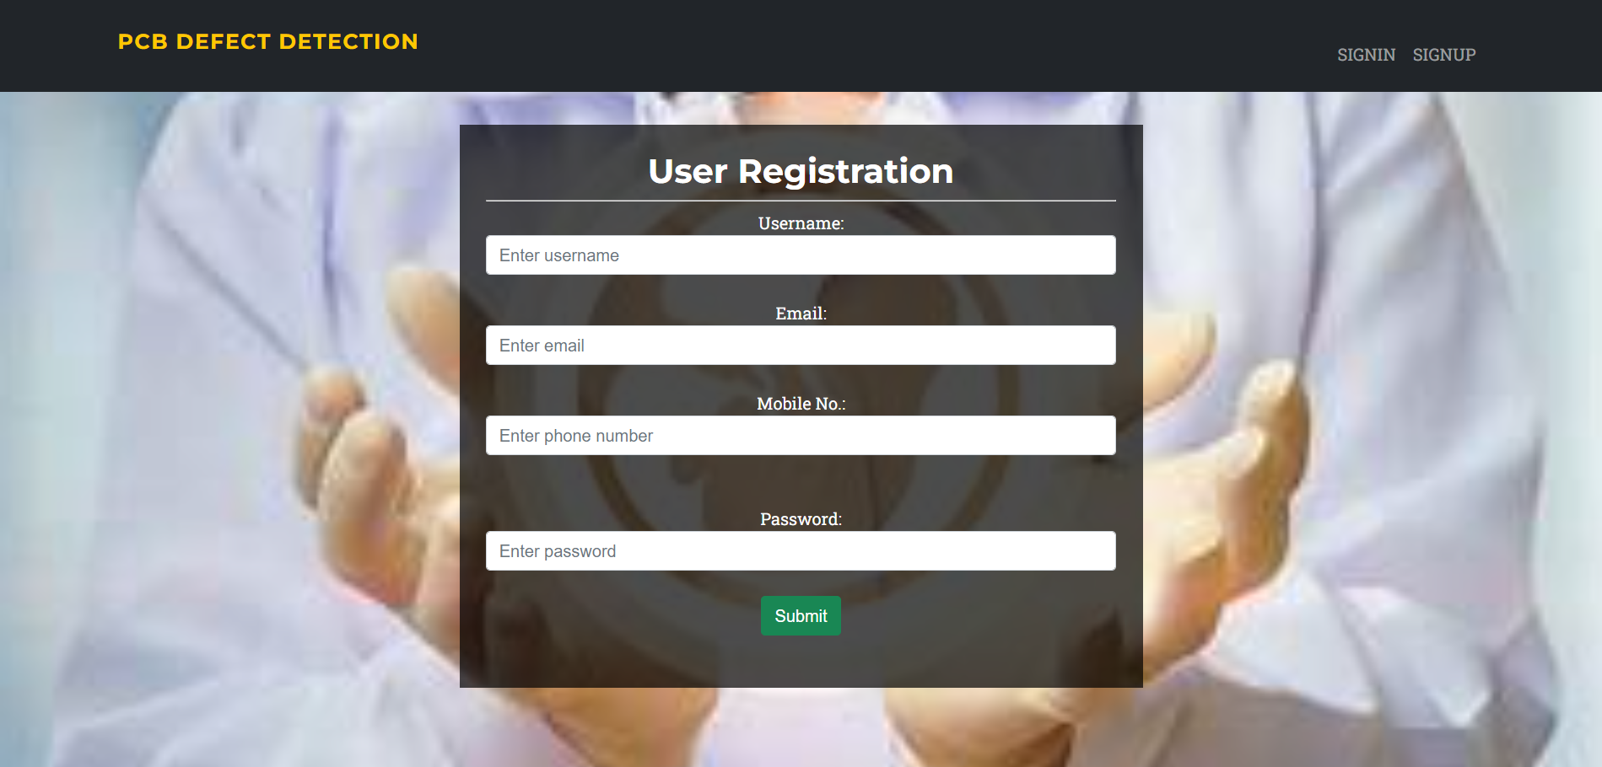
RESULT AND DISCUSSION
Experimental Results
1. Snapshot of Signup Page
The below Snapshot Figure 1 shows the snapshot of signup page.
Snapshot 1: Snapshot of Signup Page
The Snapshot 1 shows the snapshot of signup page which consists of a header which reads ’User Registration’ in it. A new user must register the username, e-mail, mobile number and password.
Dept.of CS&E, A.I.T, Chikkamagaluru

Slide 52
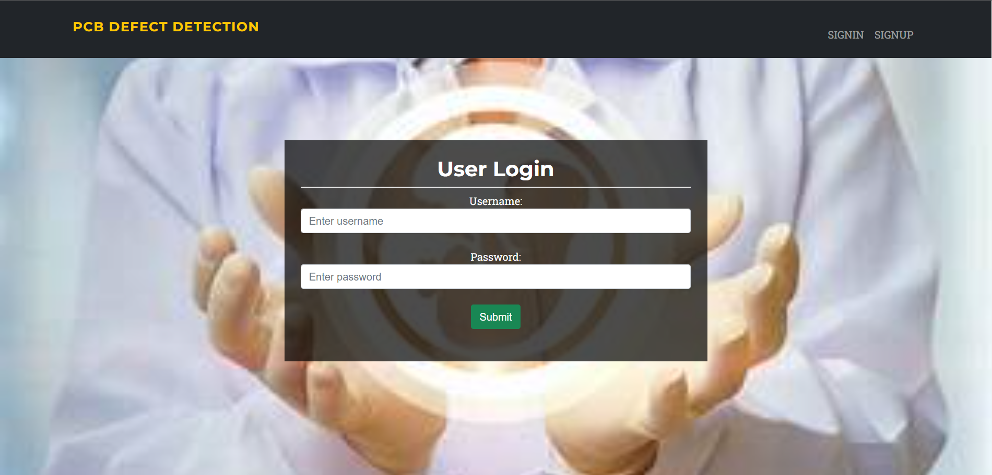
RESULT AND DISCUSSION
2. Snapshot of Sign-in Page
The below Snapshot Figure 2 shows the snapshot of signin page.
Snapshot 2: Snapshot of Sign-in Page
The Snapshot 2 shows the snapshot of sign-in page which consists of a header which reads ’User Login’ in it. The register user can login using his username and password.
Dept.of CS&E, A.I.T, Chikkamagaluru

Slide 53
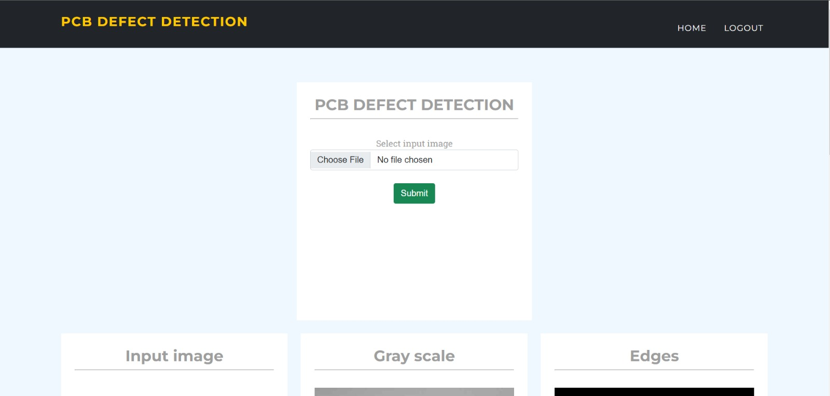
RESULT AND DISCUSSION
3. Snapshot of Home Page
The below Snapshot Figure 3 shows the snapshot of home page.
Snapshot 3: Snapshot of Home Page
The Snapshot 3 shows the snapshot of home page which consists of two buttons which are labeled ’choose file’ and ‘submit’ respectively.
Dept.of CS&E, A.I.T, Chikkamagaluru

Slide 54
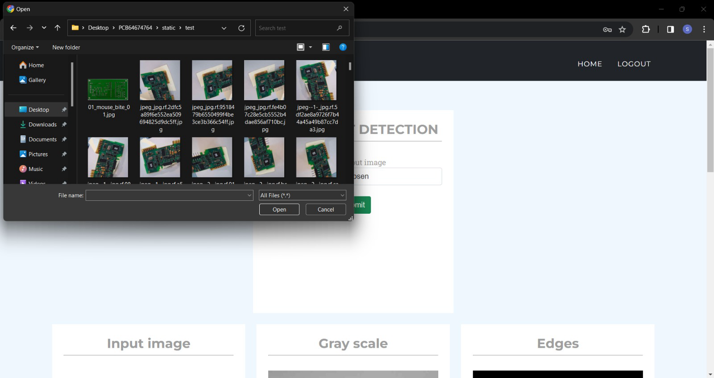
RESULT AND DISCUSSION
4. Snapshot of File Explorer on Clicking “Choose File”
The below Snapshot Figure 4 shows the snapshot of the file explorer that pops up.
Snapshot 4: Snapshot of file explorer on clicking choose file.
The Snapshot 4 shows the snapshot of file explorer window that pops up when the choose file button is clicked. The user may select the image to be classified as input to the system and let the system tell them what defect it has.
Dept.of CS&E, A.I.T, Chikkamagaluru

Slide 55
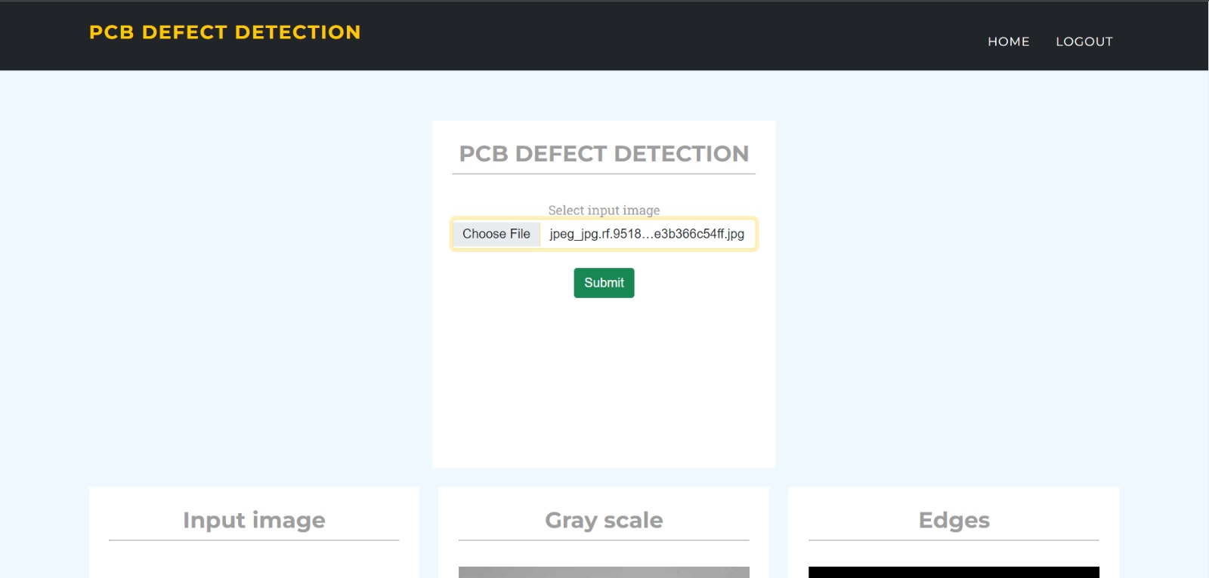
RESULT AND DISCUSSION
5. Snapshot after uploading image of Printed Circuit Board
The below Snapshot Figure 5 shows the snapshot of the same webpage after uploading the image.
Snapshot 5: Snapshot of the image name that appears.
The Snapshot 5 shows the snapshot of the webpage after uploading the image file to it. The page displays name of the image right next to the upload button.
Dept.of CS&E, A.I.T, Chikkamagaluru

Slide 56
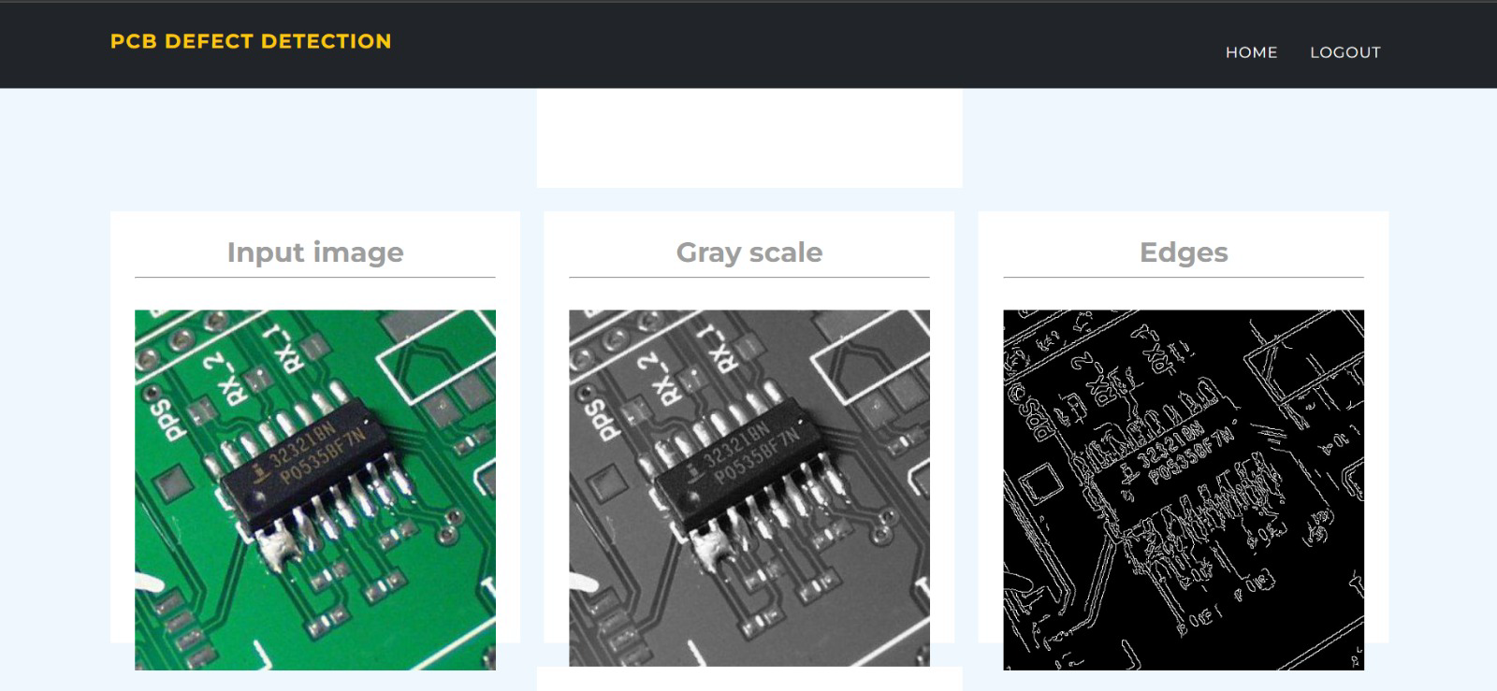
RESULT AND DISCUSSION
6. Snapshot of the Intermediate Process
The below Snapshot Figure 6 shows the snapshot of the intermediate process.
Snapshot 6: Snapshot of the Intermediate Process.
The Snapshot 6 shows the snapshot of the result of the intermediate process, which is reached on clicking the ’submit’ button.
Dept.of CS&E, A.I.T, Chikkamagaluru

Slide 57
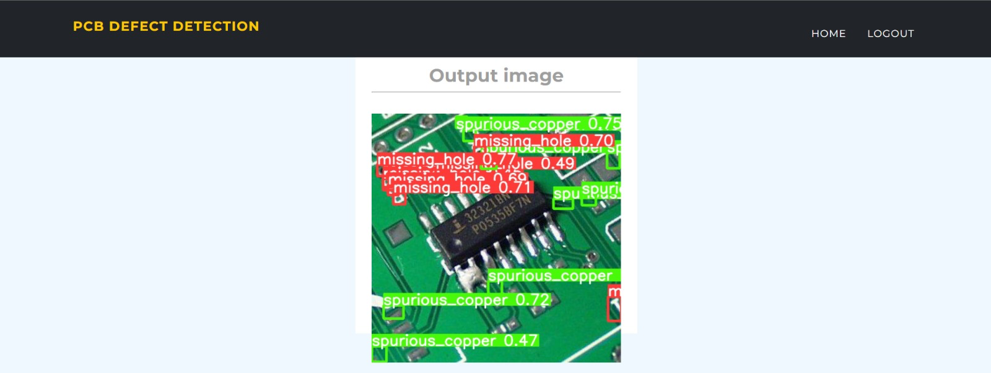
RESULT AND DISCUSSION
7. Snapshot of the Output Page
The below Snapshot Figure 7 shows the snapshot of the output result.
Snapshot 7: Snapshot of the result.
The Snapshot 7 shows the snapshot of the result. The result shows the name of the defects and position of the defects in the image.
Dept.of CS&E, A.I.T, Chikkamagaluru

Slide 58
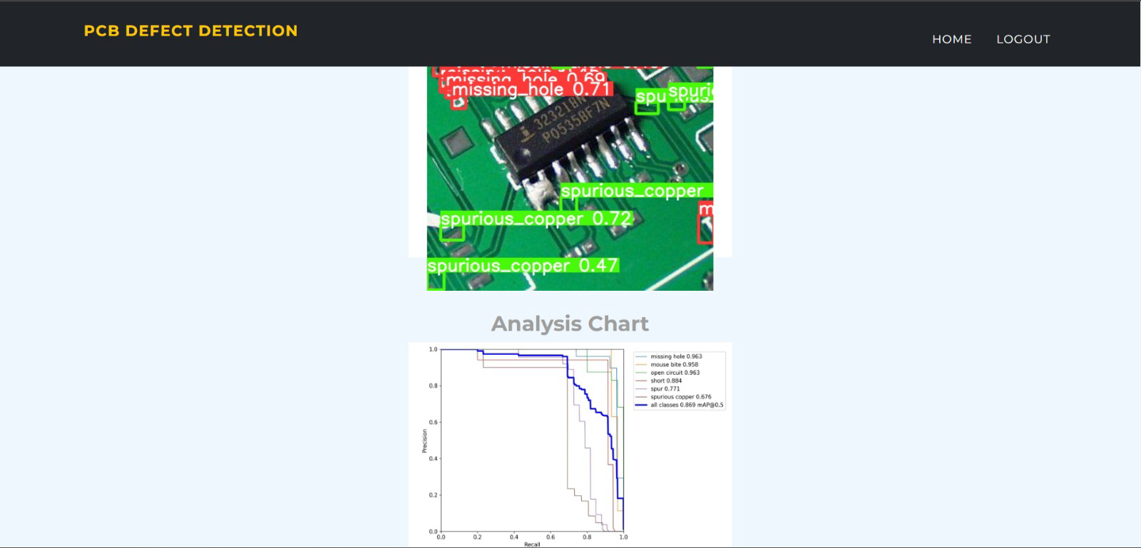
RESULT AND DISCUSSION
8. Snapshot of the Analysis Chart
The below Snapshot Figure 8 shows the snapshot of the output result.
Snapshot 8: Snapshot of the Analysis Chart.
The Snapshot 8 shows the snapshot of the analysis chart, which plots the accuracy graph of defects detected by the system.
Dept.of CS&E, A.I.T, Chikkamagaluru

Slide 59
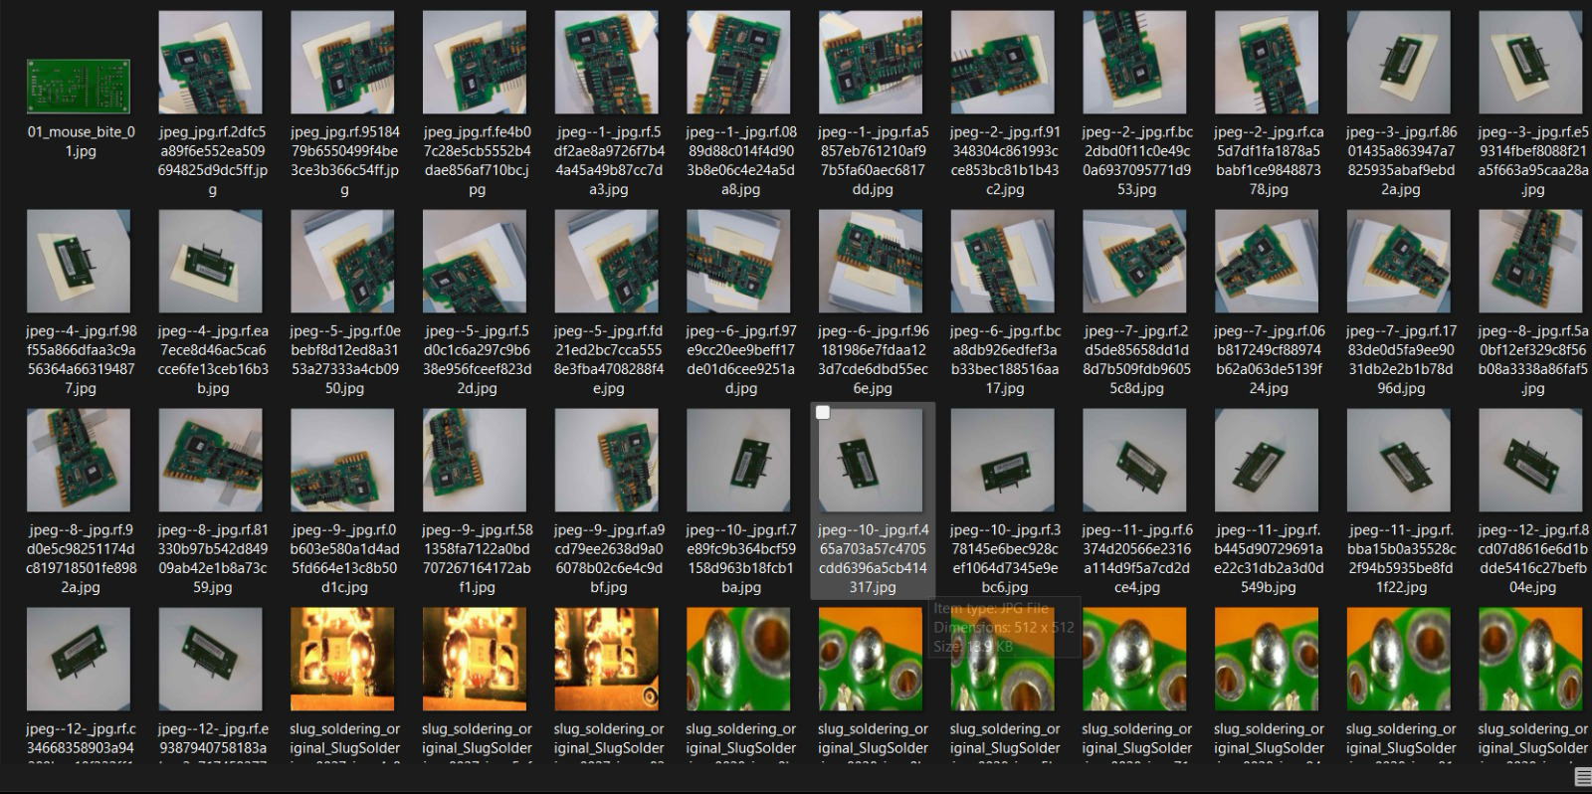
RESULT AND DISCUSSION
9. Snapshot of Datasets
The below Snapshot Figure 9 shows the snapshot of the datasets, where there is a collection of printed circuit board images.
Snapshot 9: Snapshot of the Datasets.
The Snapshot 9 shows the snapshot of the datasets which has different folders that contains certain kinds of defect printed circuit board images.
Dept.of CS&E, A.I.T, Chikkamagaluru

Slide 60
CONCLUSION
YOLOv5-based PCB defect detection system accurately identifies and classifies defects in real-time.
High detection accuracy validates YOLOv5's suitability for PCB defect detection tasks.
Real-time performance enables prompt corrective action, minimizing defective PCB production.
System adaptability to complex designs and diverse defects ensures broad applicability.
Deep learning-powered PCB defect detection automation paves the way for enhanced manufacturing efficiency and reliability.
Dept.of CS&E, A.I.T, Chikkamagaluru

Slide 61
FUTURE ENHANCEMENTS
Implementing semi-supervised learning techniques to enhance the model's defect detection accuracy with minimal human annotation effort.
Integrating adaptive learning algorithms to enable the system to dynamically update and improve its defect detection capabilities based on new data and feedback.
Extending the system's compatibility to handle diverse PCB layouts and defect types by leveraging transfer learning from related domains or incorporating generative adversarial networks (GANs) for synthetic data generation.
Introducing multi-sensor fusion capabilities to incorporate additional modalities such as thermal imaging or X-ray scans for more comprehensive defect detection and analysis.
Dept.of CS&E, A.I.T, Chikkamagaluru

Slide 62
REFERENCES
[1] Base paper: https://ieeexplore.ieee.org/document/10044670
[2] Kumar, Rajesh, Gupta and Suresh, “Machine Vision-Based Automated inspection of
PCBs: A Comparative Study”. In Proceedings of the 2017 IEEE Region, Cochin, India, 14–
16 July 2017.
[3] Thomas, Gupta and Subramanian, “Smart surveillance based on video summarization”,
2019.
[4] Lee, Hyun; Kim, Seong; Park, Min, ”Defect Detection in PCBs using Transfer Learning
with Pretrained CNNs”,2018.
[5] Anoop K.P, Sarath N.S and Sasi Kumar V.V, “A Review of PCB Defect Detection using
Image Processing”,2019.
Dept.of CS&E, A.I.T, Chikkamagaluru
62

Slide 63
THANK YOU

